Slide 1
PAGE 1 (4 minutes)

Slide 2
PAGE 2 (4 minutes)
THERE IS NO IMAGE FOR
THIS PAGE OF QUESTIONS

Slide 3
PAGE 3 (2 minutes)

Slide 4
PAGE 4 (2 minutes)
THERE IS NO IMAGE FOR
THIS PAGE OF QUESTIONS

Slide 5
PAGE 5 (4 minutes)

Slide 6
PAGE 6 (4 minutes)
Cr
Ca

Slide 7
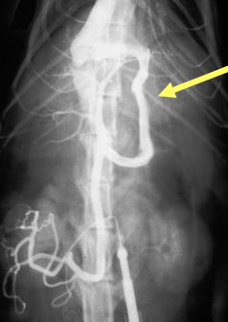
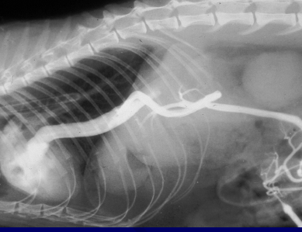
PAGE 7 (4 minutes)
R
R

Slide 8
PAGE 8 (4 minutes)
THERE IS NO IMAGE FOR
THIS PAGE OF QUESTIONS

Slide 9
PAGE 9 (4 minutes)
THERE IS NO IMAGE FOR
THIS PAGE OF QUESTIONS

Slide 10
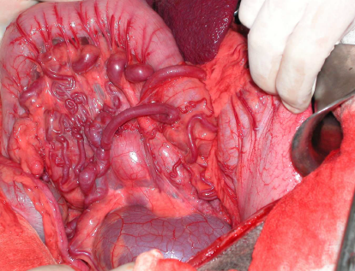
PAGE 10 (4 minutes)

Slide 11
PAGE 11 (4 minutes)
THERE IS NO IMAGE FOR
THIS PAGE OF QUESTIONS

