Slide 1
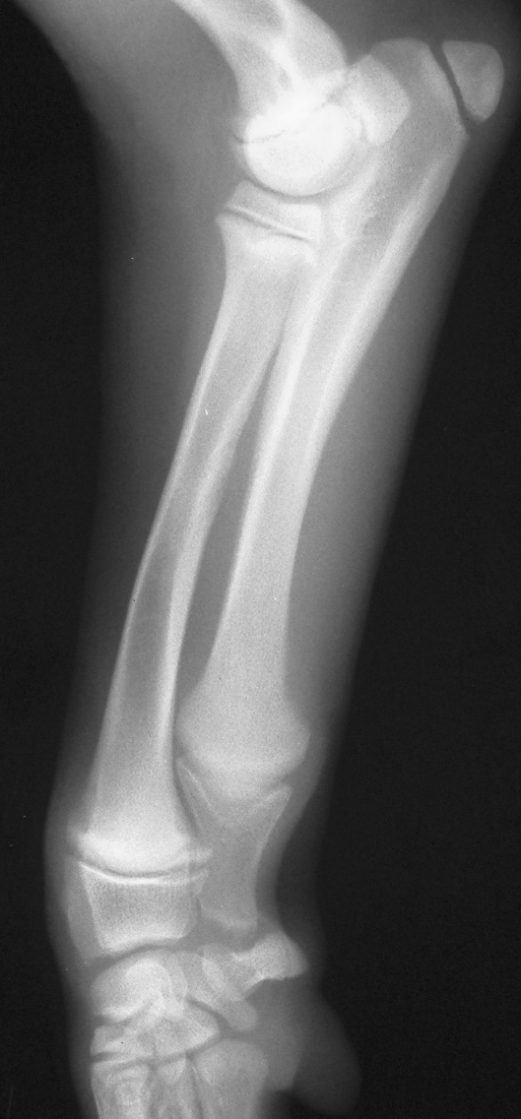
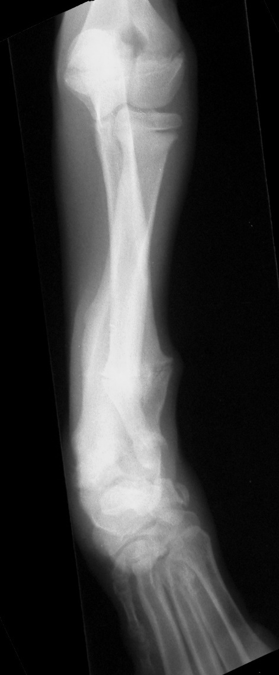
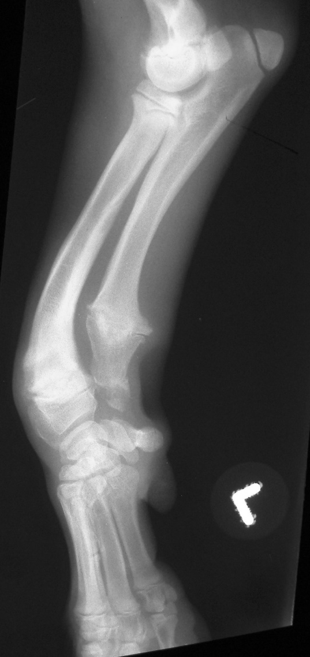
PAGE 1 (4 minutes)
R
R
L
L

Slide 2
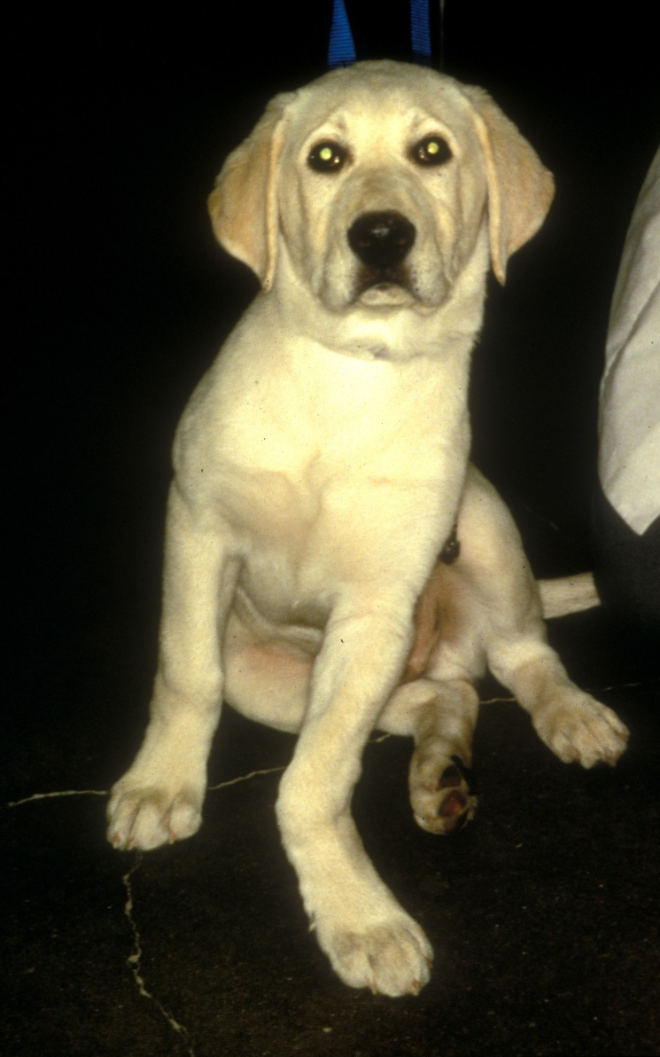
PAGE 2 (2 minutes)

Slide 3
PAGE 3 (4 minutes)
A
B

Slide 4
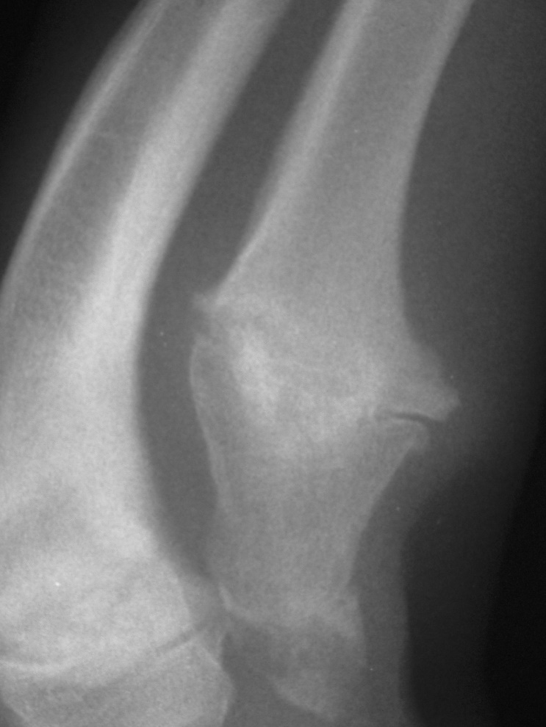
PAGE 4 (4 minutes)

Slide 5
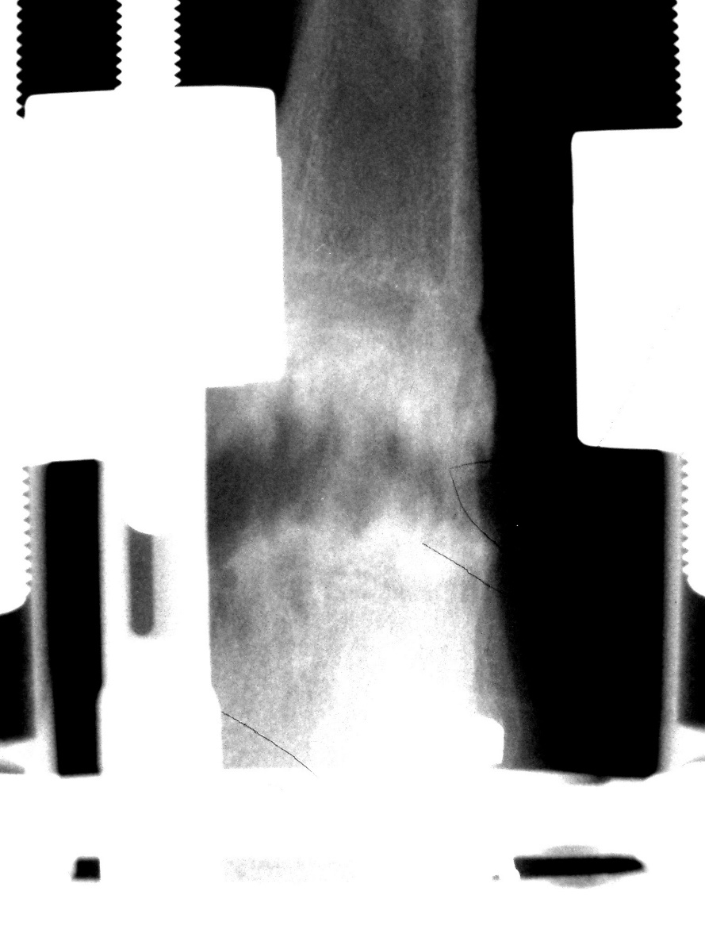
PAGE 5 (4 minutes)

Slide 6
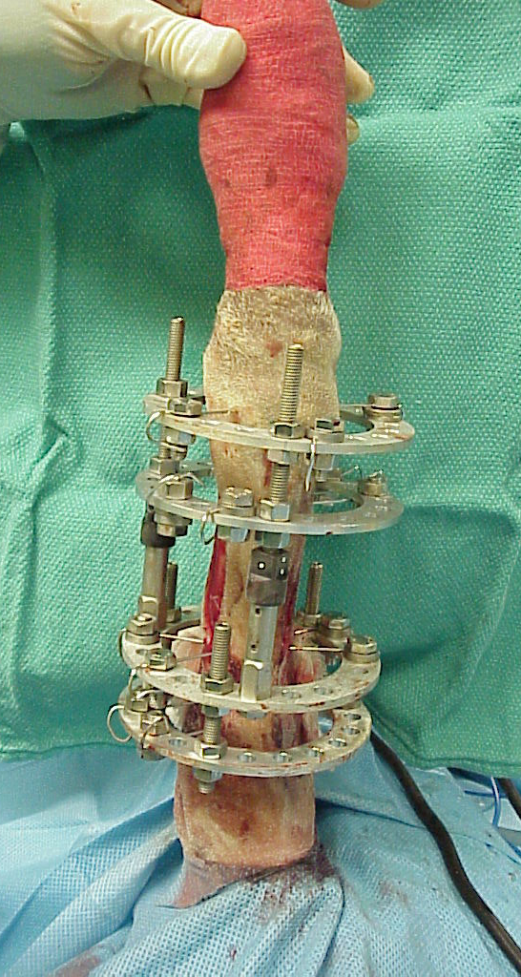
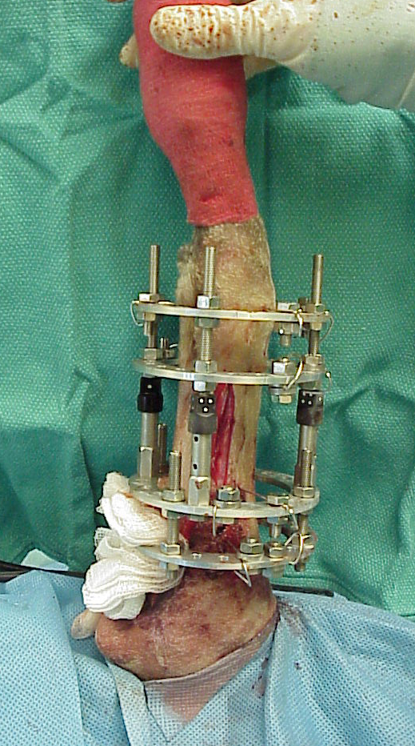
PAGE 6 (4 minutes)

