Slide 4
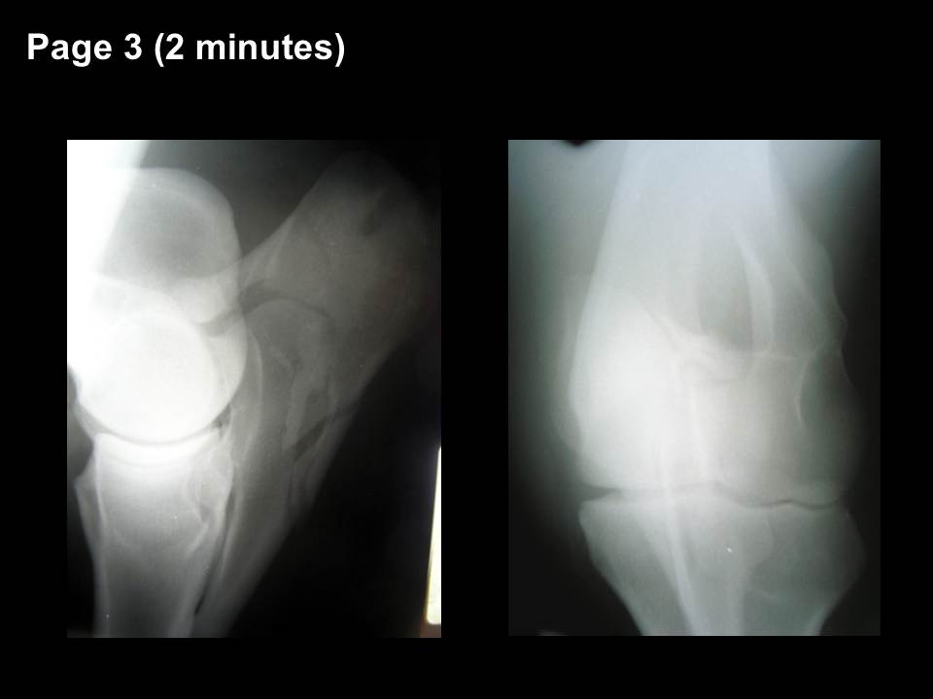

Slide 10
Page 9 (4 minutes)

Slide 13
