Slide 1
Large Animal Soft Tissue Case Assessment
American College of Veterinary Surgeons

Slide 2
Page #1 4 minutes
THERE IS NO IMAGE FOR
THIS PAGE OF QUESTIONS

Slide 3
Page #2 4 minutes
THERE IS NO IMAGE FOR
THIS PAGE OF QUESTIONS

Slide 4
Page #3 4 minutes
C→
B
A

Slide 5
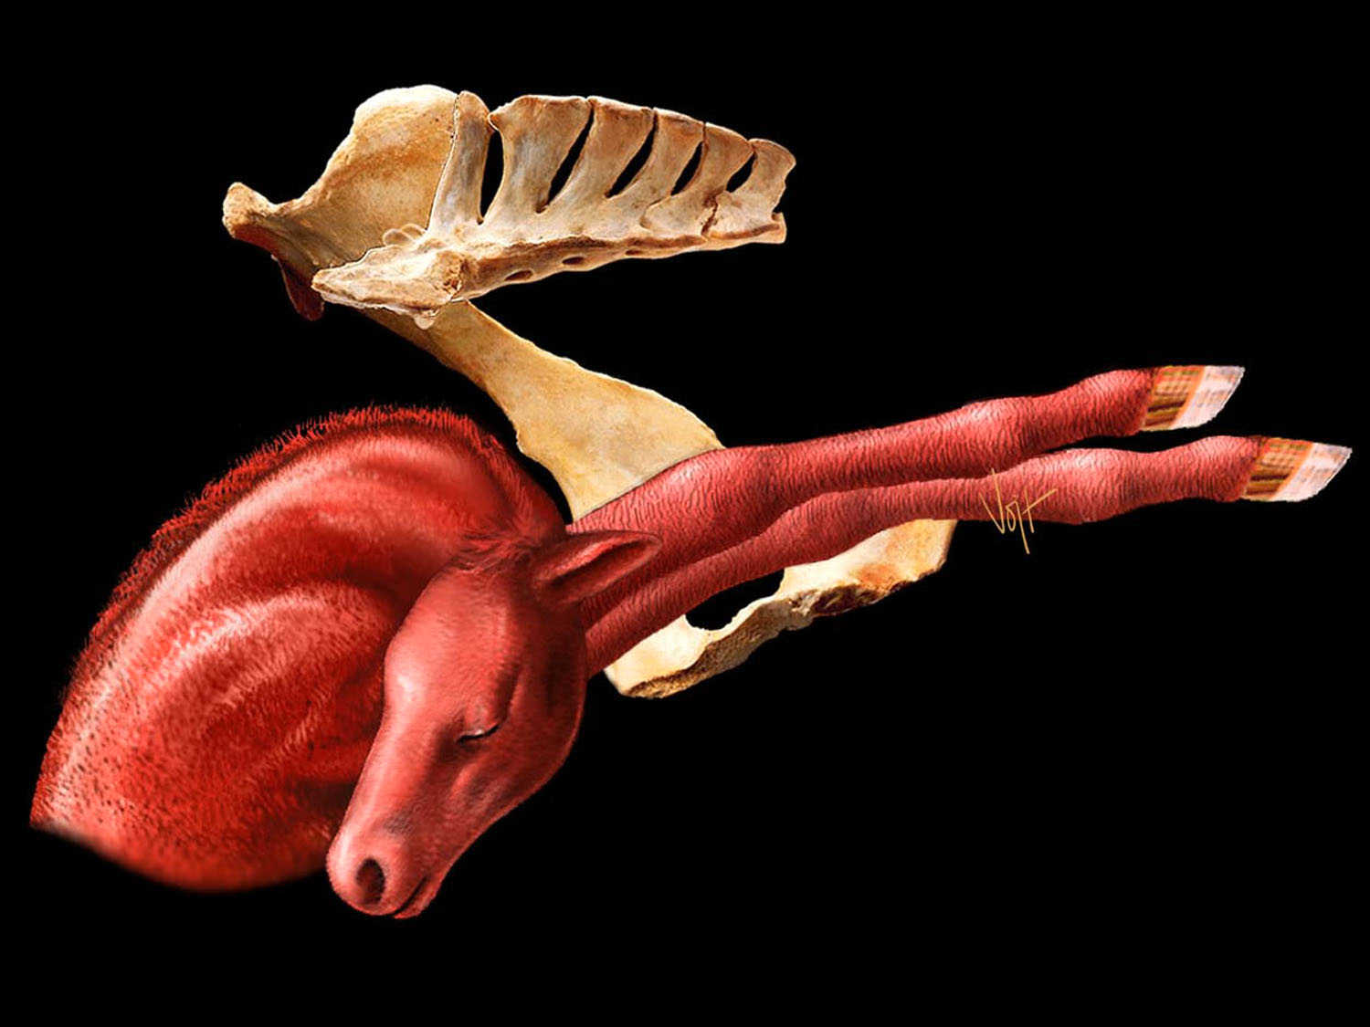
Page #4 4 minutes

Slide 6
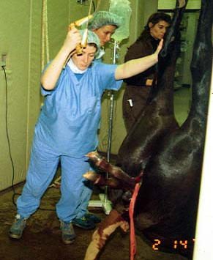
Page #5 4 minutes

Slide 7
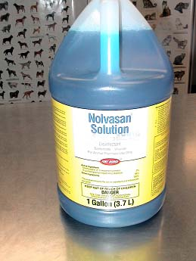
Page #6 2 minutes

Slide 8
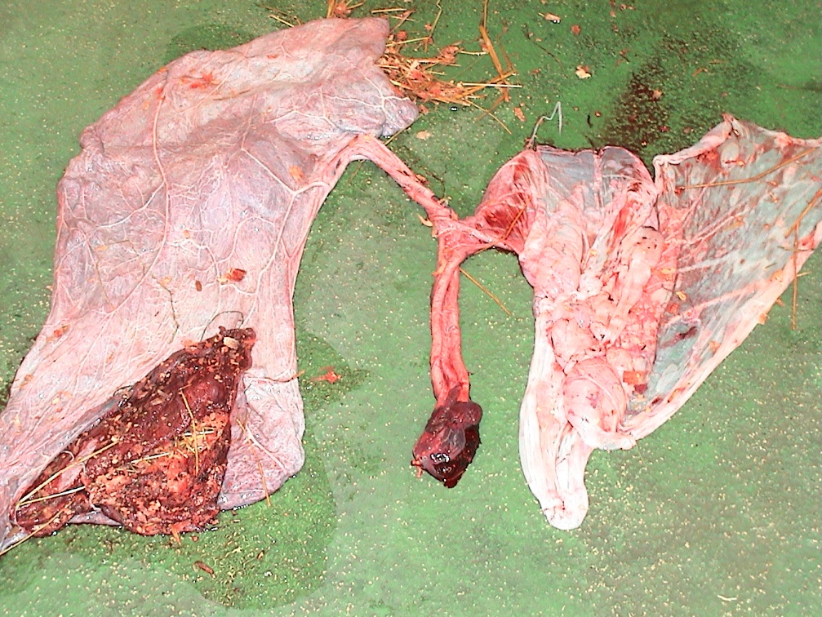
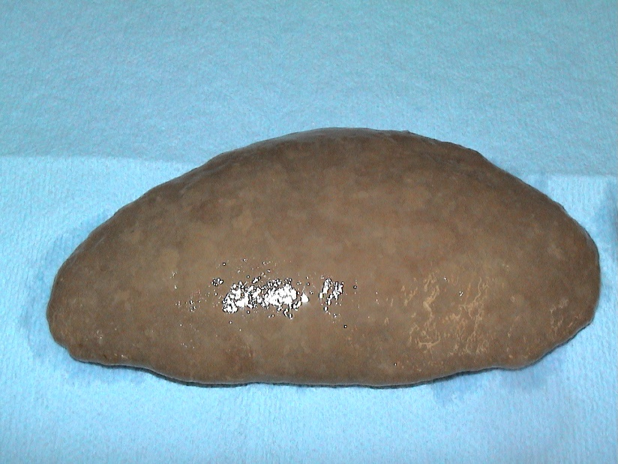
Page #7 4 minutes
2
1
C
A
B
C
B
3
A
= 1 cm

Slide 9
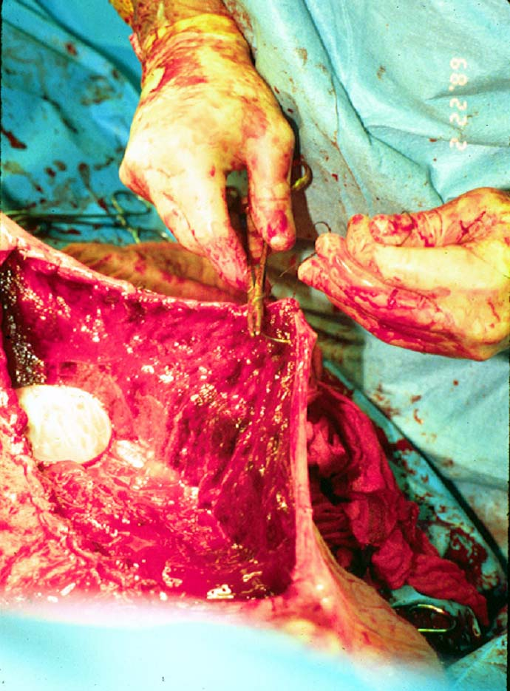
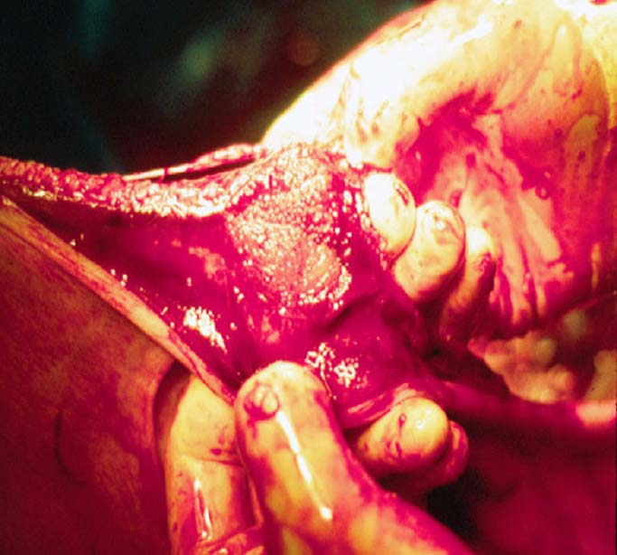
Page 8 4 minutes
2.
1.

Slide 10
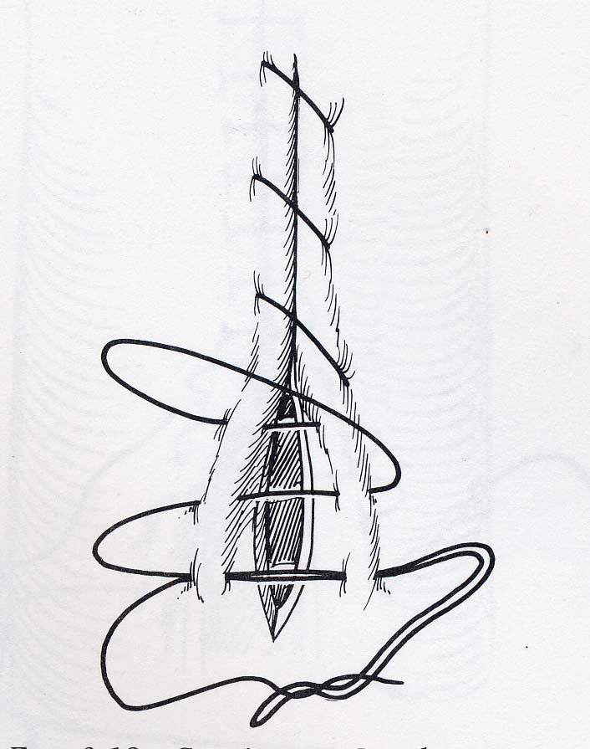
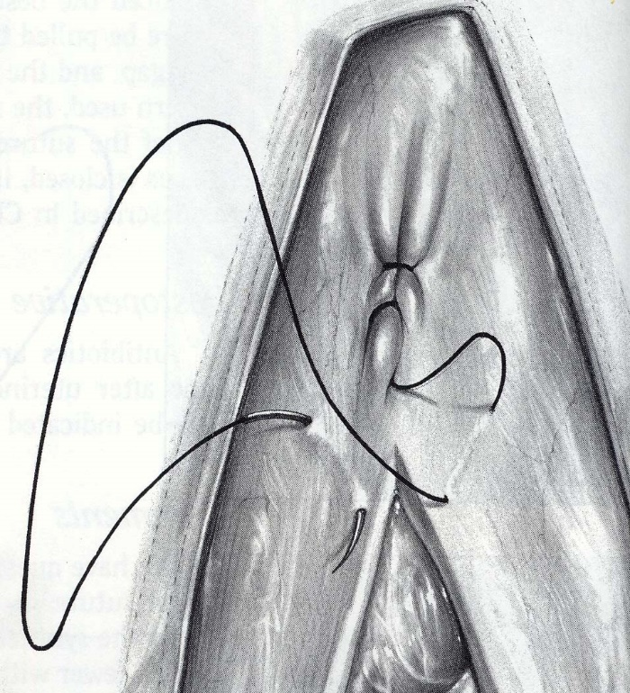
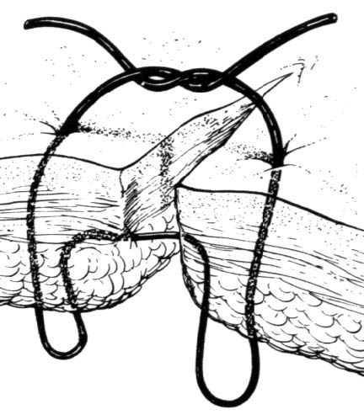
Page #9 4 minutes
1.
2.
1.
4.
3.

Slide 11
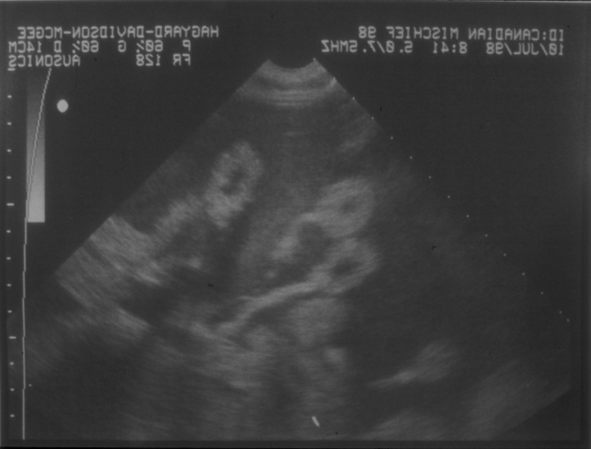
Page #10 4 minutes
B
A →

Slide 12
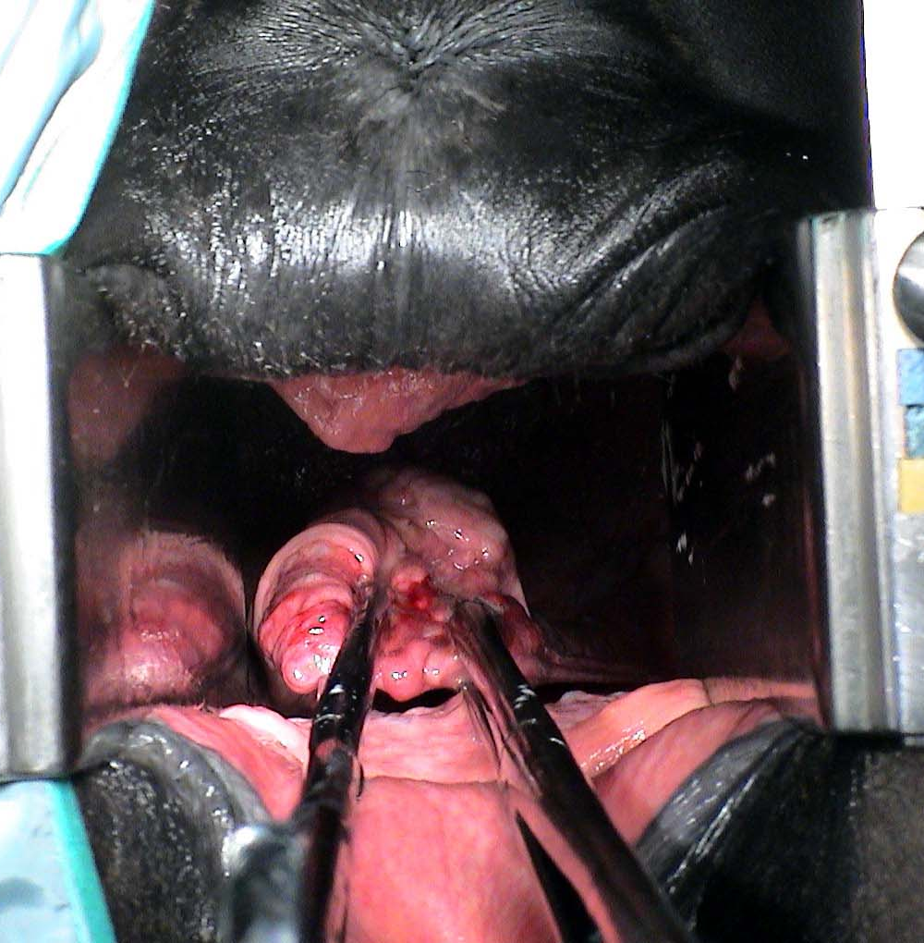
Page #11 4 minutes

Slide 13
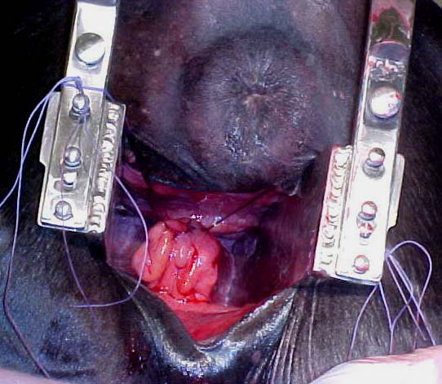
Page #12 4 minutes
C →
C →
A
B⇑

